Slide 1

OWNING YOUR HOME
OPTIONS FOR TITLE AND SUCCESSION ISSUES
Cameron L. Hess, Esq., CPA
(916) 920-5286 chess@wkblaw.com
Wagner Kirkman Blaine
Klomparens & Youmans LLP
Sacramento Walnut Creek

Slide 2

Owning Your Home - Options

Slide 3

1. Single
Title: John Smith {optional:…, an unmarried man (married man, as his separate property)}
Pluses
Simple [If NOT community property]
Succession
Probate: Generally Yes (some exceptions)
By Will: Pass per bequest [if not CP]
Intestate: Spouse/Child(ren): 50/50; 1/3; 2/3.
No Children – Spouse/Family – 50/50

Slide 4
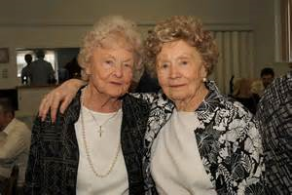
2. Tenant-in-Common (Simple)
Title: “John Smith and Dawn Lee, as tenants in common” (May designate %.)
Pluses:
Simple – each “co-tenant has separate rights”
Owners – may be spouses, RDPs, friends
Succession
Each Tenant – same as Single.
Spouses – May use 13540 Affidavit (40 day wait)
Property Tax Exclusion
Same as single – parent-child exclusion, spousal exclusion
Bonus: Special co-tenant exclusion for personal residences

Slide 5

3. Joint Tenancy
Title: “John Smith and Dawn Lee,
as joint tenants”
Pluses:
Undivided Joint Interest
Owners – Anybody! (Spouse, child)
Succession
Title Passes by Law → Surviving Joint Tenants (Affidavit)
Property Taxes
None prior to death of “original owners”
Basis Step Up: Yes -% interest OR
H & W - 100% if Community Prop Code 1014(b), Lucas(80)
Community Prop: Complex Civ Code §4800.1

Slide 6
4. Community Property With Right of Survivorship (CPWROS)
Title: “X & Y, as community property with right of survivorship”
Pluses
Simple – Spouses/RDPs
No Probate: (Spouse takes) – (Affidavit)
Concerns:
Not always appropriate – 2nd marriages –Issue for smaller estates if need to leave something to children.
May be “transmutation” of separate property.
Does not cover “simultaneous death”

Slide 7
Revocable Transfer on Death Deeds
NEW!
Statutory Deed: Language Unique. Must follow
Revocable.
Not effective until die.
Use:
Residential Property: 1-4 residential units,
Condominium,
Ag land 40 acres or less with single-family residence. (Cal. Prob. Code § 5610)

Slide 8
Revocable TOD Deed
Legal Issues
Recorded: Use statutory language & record
w/n 60 days of execution &
by 1/1/2021.
Beneficiary:
Must specifically "identify” by FULL name (> 1+ okay) – and some clarity – daughter, friend, etc.)
All take equally (Ben’s death removed him)
Omitted heirs unprotected
Surviving issue of beneficiary don’t take

Slide 9
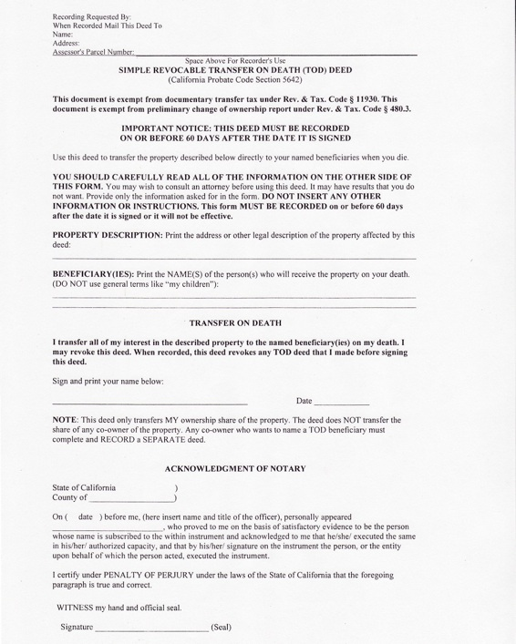

Slide 10
Pros & Cons of TODs
Pros
Easy and avoids probate.
Easily revoke or change
Cons
Risk of beneficiary dispute?
Failure to Update – No “Plan B”
Death of beneficiary
Loss of competency

Slide 11
Recordation
60 Day Rule.
Must recorded on or </= 60 days from execution. If too late it’s invalid.
May record after transferor's death.
Risks: “secret recording.” Caretaker gets signature just before death – claiming title. (Risks higher in LA.)
Sunset Date.
Must execute before January 1, 2021. (If execute & record, will remain effective after sunset.

Slide 12
Revocation
How
Formal revocation. §5644 Recording
Successor TOD
Transfer Property – including into a Trust
Warning:
Rules different than “standard”. Effective document may be based on date executed, not date recorded.

Slide 13
Tax Consequences
Execution and Recordation:
NONE
Estate Tax: Value @ Death includes Real property described in the TOD Deed. IRC § 2038
Income Tax: All income tax remains reportable by the transferor.

Slide 14
Joint Tenancy and CPWROS
Revocable TOD Ineffective if Title held as:
Community Property With Right Of Survivorship.
Joint Tenancy.

Slide 15
Spouses
Separate Property. TOD Deed supersedes both wills and intestate succession
Community property. Spouse must file legal action to set aside (as to his/her ½ interest only) if he or she never joined in or consented to the TOD deed.
Divorced Spouse. Non-probate transfer to spouse is automatically revoked.

Slide 16
Trusts

Slide 17
Revocable Inter Vivos Trust
Concept: Property put “in trust.” Grantors = initial trustees/beneficiaries. Does NOT change character as community/separate.
Use:
Avoid probate.
Operations/Distributions:
No change while both living
Power to revoke/modify/buy-sell

Slide 18
Revocable Inter Vivos Trust
Example 1: Simple. Revocable for surviving spouse. Passes to children.
Example 2: Marital @ First Death. (Joint estate < $11M.) @ 1st Spouse passing: Marital Trust (irrevocable) + Survivor’s Trust created. Elect portability of full $5.45M exclusion.
Example 3: Bypass @ First Death. (Joint estate > $11 million) @ 1st spouse to pass - Bypass + Surviving Spouse (+ Marital?). Bypass Trust uses some/all of unified credit.

Slide 19
Revocable Inter Vivos Trust
What Are People Doing These Days:
Most: Simple or Marital Trust – Portability – Estates under $11 Million.
Original Purpose of Trusts – Not estate taxes, but succession!
Bypass Trusts: May no longer be “best option”. Consider revising if estate not likely to exceed $11 million. (But do consider for larger estates!)

Slide 20
Revocable Inter Vivos Trust
Title: “John Smith and Dawn Smith, Trustees of the Smith Family Trust, dated November 8, 2013”
No Probate: Trustee changes @ death.
Asset Protection: Possibly – 1st spouse’s death
Tax Features:
Step Up at Death: 100% step-up (SP + CP)
Property Tax: Spousal/Parent-child
Concerns:
Cost to Draft Complexity/Capacity

Slide 21
Trust verses Probate
Are Trusts More Expensive?
Initial Cost:
Trust: Prep. - $1,500-$3,000 + costs @ Death: Attorney– hourly
Will: While Alive: Free or $750-$1300
TOD/JT Deed: Nominal
Do Nothing: Free

Slide 22
Trust verses Probate
Later Costs:
Trust: As needed – hourly rate. Still a number of “statutory duties” (it’s hard work to die.)
Will:
Court Costs (+400 each filing)
Statutory Probate Fee
Extraordinary Fees (Real estate sale, etc. hourly.)
Probate Fee: (4% -$100K, 3% next $100K, 2% next $800K, 1% next $9M , 0.5% next $15M, Reasonable $>$25M)
Example: $400,000 house. Fee = $11,000

Slide 23
How Long Does Probate Take?
Will/Probate:
Timing: If smooth – 6-9 months. 4 Month creditor period mandatory. Inventory and Appraisal. Final accounting and distribution. Some items require court approval. May take longer (much longer.) Any beneficiary can delay court by just showing up.
Trusts:
Creditor Period. Not required (optional)
Accounting. Beneficiaries can waive
Valuation: Possibly if helpful/needed (real property). No, if simple.
Delay – Less Frequent: Beneficiary has to file court action.

Slide 24
Thank You
Cameron L. Hess, CPA, Esq.
(916) 920-5286
chess@wkblaw.com

